Slide 1
Interim Results
for the six months ended 31 December 2014

Slide 2
Disclaimer
This presentation is provided on a confidential basis.
The name 'Presenter' refers to Pan African Resources PLC and its advisors, subsidiaries or affiliated companies.
This presentation has not been filed, lodged, registered or approved in any jurisdiction and recipients of this document should keep themselves informed of and comply with and observe all applicable legal and regulatory requirements.
Statements or assumptions in this presentation as to future matters may prove to be incorrect. The Presenter makes no representation or warranty as to the accuracy of such statements or assumptions. Circumstances may change and the contents of this presentation may become outdated as a result, and the Presenter has no obligation to update the presentation or correct any inaccuracies or omissions in this presentation.
Recipients should not treat this presentation as advice relating to legal, taxation or investment matters and are advised to consult their own professional advisers.
This presentation may not be reproduced in whole or in part, nor may any of its contents be divulged to any third party without the prior consent in writing of the Presenter.
The recipient acknowledges that neither it nor the Presenter intends that the Presenter act or be responsible as a fiduciary to the recipient, its management, stockholders, creditors or any other person. Each of the recipient and the Presenter, by accepting and providing this presentation respectively, expressly disclaims any fiduciary relationship and agrees that the recipient is responsible for making its own independent judgments with respect to any transaction and any other matters regarding this presentation.
Furthermore, the information contained in this presentation may also qualify as “inside information” as defined in the Securities Services Act, 36 of 2004 (“SSA”). In terms of the SSA, it is a criminal offence for a person who knows that he or she has inside information to –
deal directly or indirectly or through an agent for his or her own account, or for the account of another person, in listed securities to which the inside information relates;
disclose the inside information to another other than in the proper course of a person’s employment, profession or duties; and
encourage or cause another person to deal or discourage or stop another person from dealing in the listed securities to which the inside information relates.
The Presenter makes no representations as to the actual value which may be received in connection with a transaction nor the legal, tax or accounting effects of consummating a transaction. Unless the expressly contemplated hereby, the information in this presentation does not take into account the effects of a possible transaction or transactions involving an actual or potential change of control, which may have significant valuation and other effects. The Presenter shall not have any liability for any loss suffered due to reliance being placed on this presentation, the information contained herein or the oral presentations referred to.
This presentation is for information purposes only and does not constitute an offer or invitation to subscribe for or purchase any securities, and neither this presentation nor anything contained therein nor the fact of its distribution shall form the basis or be relied on in connection with or act as any inducement to enter into any contract or commitment whatsoever.

Slide 3
PAN AFRICAN RESOURCES “CURRENT SNAPSHOT”
Well established mid-tier SA miner
Interim results impacted by Evander low grade mining cycle and S54 imposed stoppages
Final FY2015 results expected to show marked improvement due to:
Evander Mines exiting the low grade mining cycle
BIOX® recoveries stabilised at Barberton
ETRP producing gold from January 2015
ZAR258 million dividend paid in December 2014 demonstrates confidence in operations
Group well positioned to continue generating returns for shareholders

Slide 4
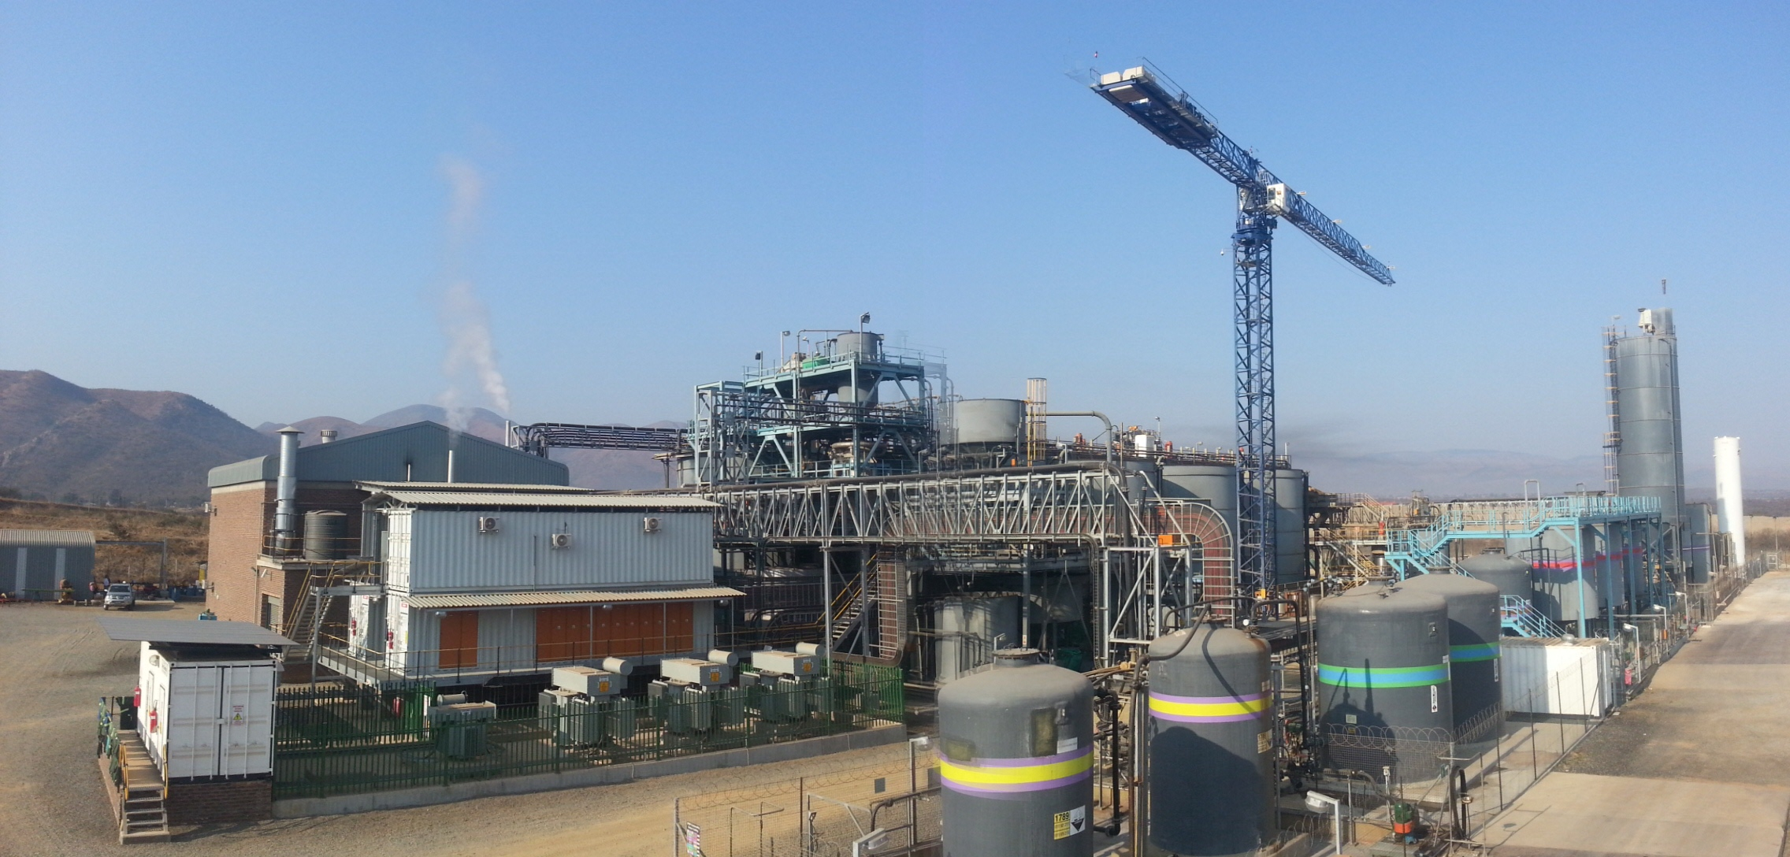
Group Results Overview

Slide 5
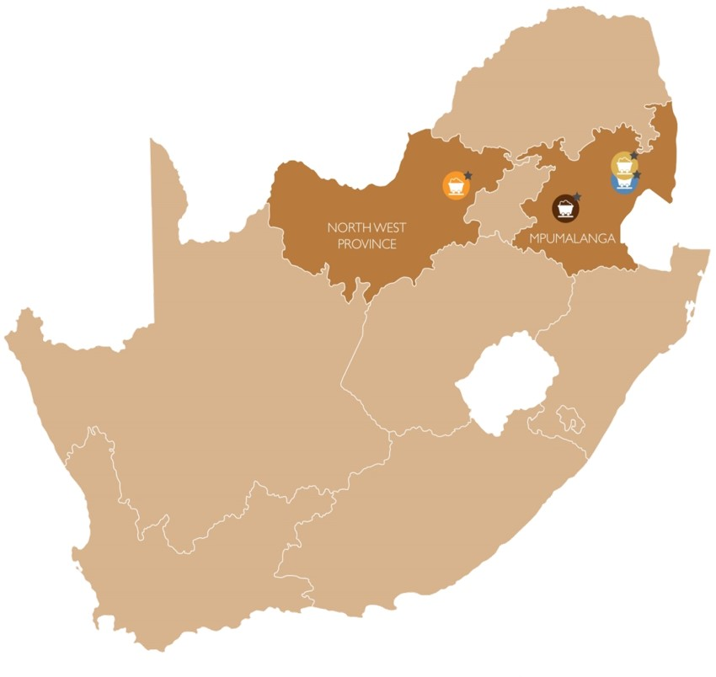
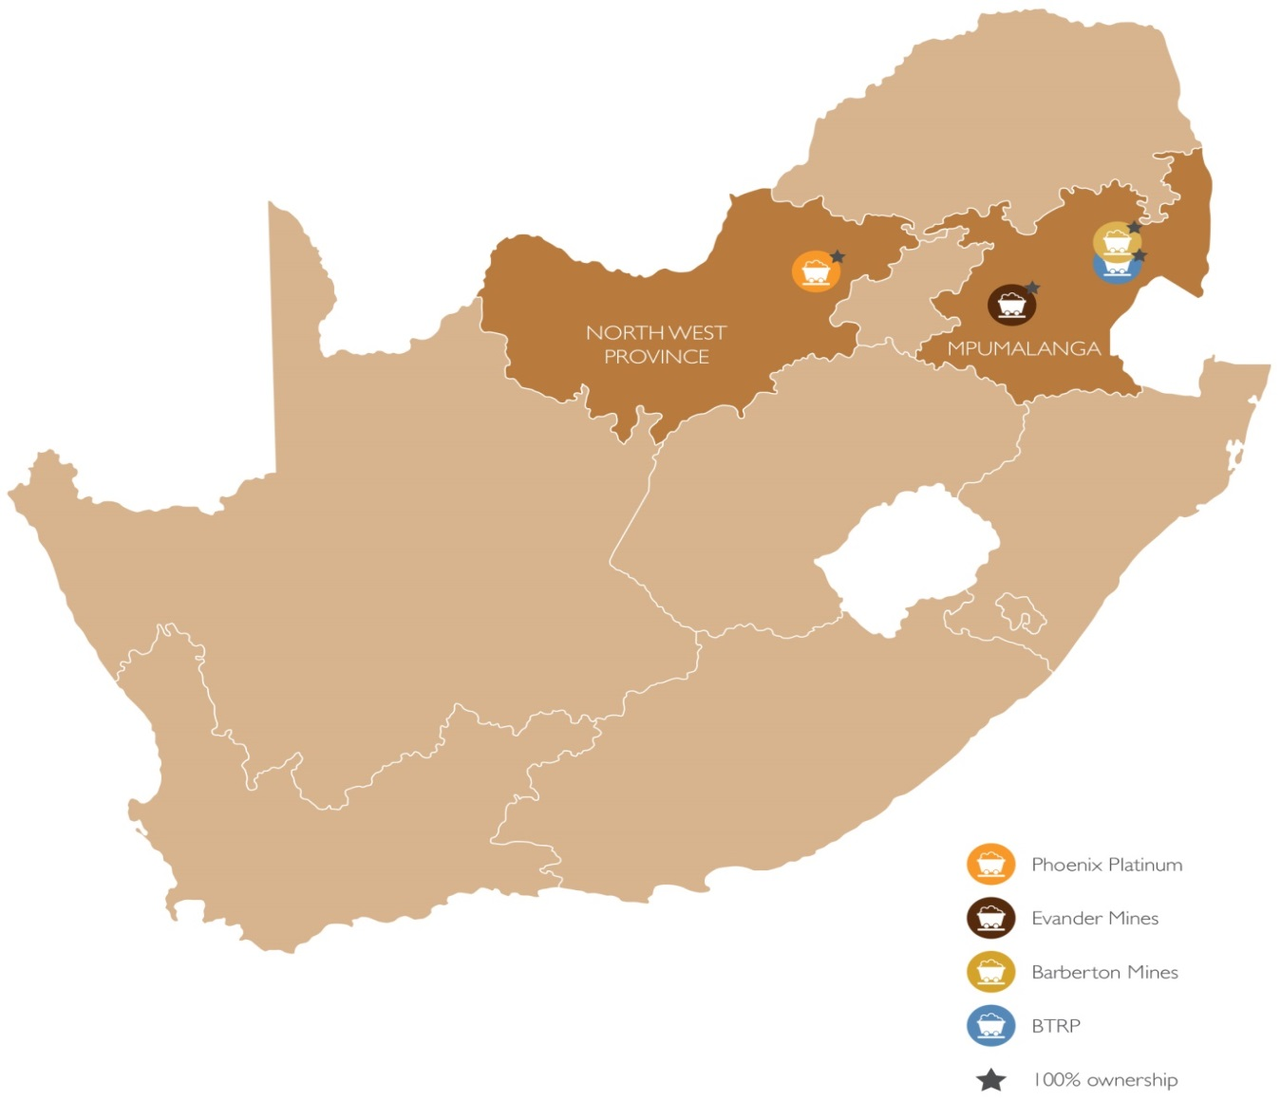
GEOGRAPHICAL MAP
NORTH
South Africa
JOHANNESBURG

Slide 6
Pan African Resources PLC
KEY FEATURES FOR THE SIX MONTHS ENDED 31 DECEMBER 2014
GOLD SOLD
CASH COST
HEADLINE EARNINGS
PHOENIX
PGE’S SOLD
ETRP
Completed on time
and within budget
First gold production in
January 2015
⬇
13.5%
⬆
30.3%
⬇
62.8%
⬆
57.7%
2014: 86,675oz
(2013: 100,172oz)
2014: ZAR351,461/kg
(2013: ZAR269,670/kg)
2014: ZAR102.6 million
(2013: ZAR275.9 million)
2014: 4,711oz
(2013: 2,987oz)

Slide 7
GROUP - Safety Performance
Accident Rates

Slide 8
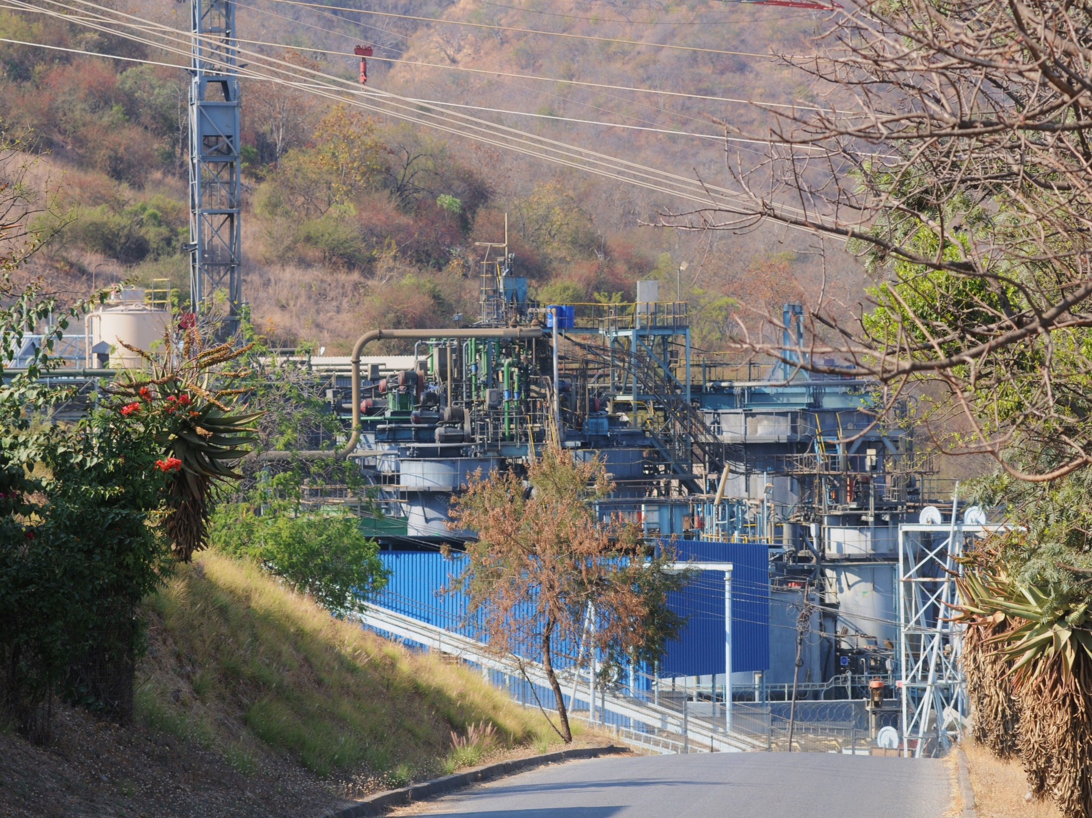
BARBERTON MINES

Slide 9
BARBERTON MINES
Reduction in gold sold to 52,942oz (2013: 57,008oz) due to:
Section 54 imposed stoppage
BIOX® plant oil contamination
Unplanned production interruptions to underground operations
Barberton remains a low cash cost producer at ZAR279,150/kg (2013:ZAR232,611/kg)
Gold production at BTRP stabilised at 11,710oz (2013: 11,603oz)
BTRP achieved plant recoveries of 51% (2013: 60%)
BTRP cash cost very competitive at ZAR162,203/kg (2013:ZAR146,928/kg)

Slide 10
BARBERTON MINES
BIOX® RECOVERIES

Slide 11
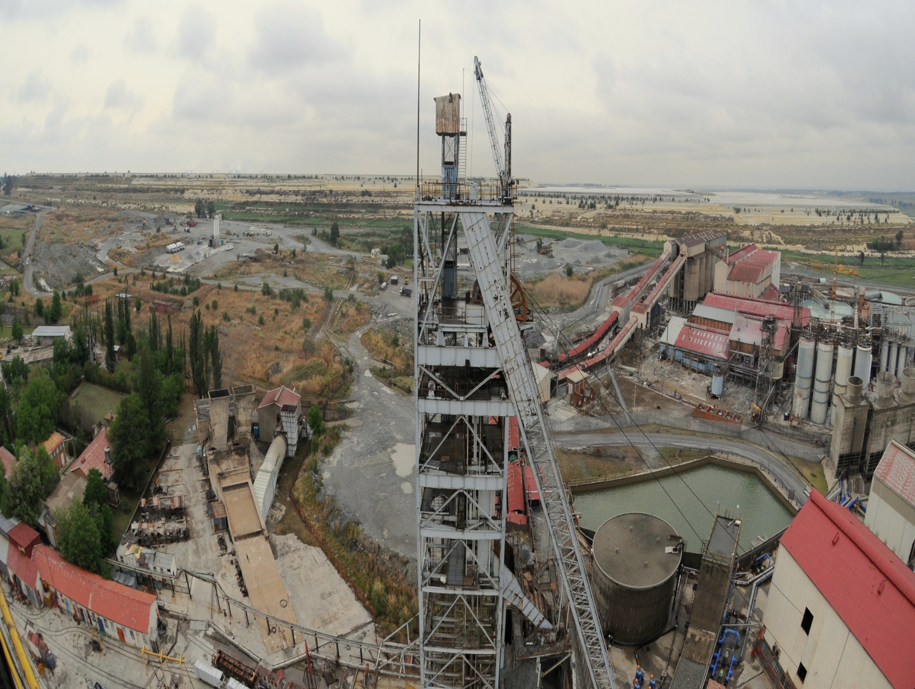
EVANDER MINES

Slide 12
EVANDER MINES
Reduction in gold sold to 33,733oz (2013: 43,154oz) due to:
Low grade mining cycle
Section 54 imposed stoppage
Unplanned production interruptions from underground
8 Shaft mining cycle now trending to higher grades
ETRP completed on schedule and on budget
First gold from ETRP in January 2015
ETRP forecasted cash cost of ZAR300,000/kg

Slide 13
Evander Mines
HISTORICAL Gold Sold vs HEAD GRADE

Slide 14
EVANDER MINES
8 SHAFT – GRADE PROFILE (ACTUAL & FORECAST)

Slide 15
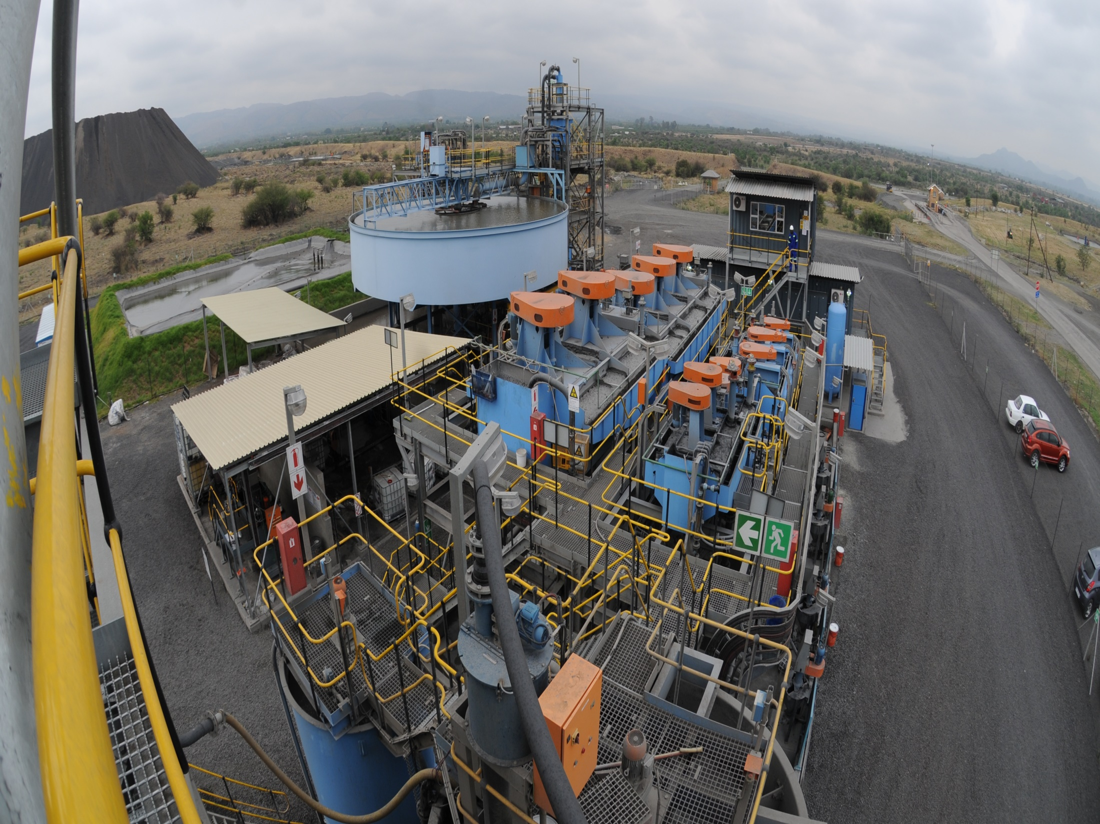
PHOENIX PLATINUM

Slide 16
PHOENIX PLATINUM
PGE sales increased by 57.7% to 4,711oz (2013: 2,987oz)
Plant recoveries increased to 34% (2013: 24%)
Cash cost decreased to USD 621/oz (2013: USD 843/oz)
Phoenix Platinum cash-generative and profitable – H1 EBITDA of ZAR13.5 million (2013: ZAR1.7 million)

Slide 17
FINANCIAL REVIEW
COBUS LOOTS, FD

Slide 18
Pan African Resources PLC
Summarised consolidated results
 | For the six months ended 31 December 2014 |  | For the six months ended 31 December 2013
 | ZAR | GBP | ZAR | GBP
Revenue (millions) | 1,217.4 | 68.1 | 1,349.1 | 84.6
EBITDA (millions) | 230.6 | 12.9 | 450.8 | 28.3
Attributable earnings (millions) | 99.2 | 5.5 | 275.9 | 17.3
Headlines earnings (millions) | 102.6 | 5.7 | 275.9 | 17.3
EPS (cents/pence) | 5.42 | 0.30 | 15.11 | 0.95
HEPS (cents/pence) | 5.61 | 0.31 | 15.11 | 0.95
Dividend paid (cents/pence) | 14.10 | 0.82 | 13.14 | 0.80
Net debt (millions) | 458.6 | 25.7 | 101.0** | 5.6**
Number of shares (millions)* | 1,830.0 | 1,830.0 | 1,825.6 | 1,825.6

Slide 19
Financial Summary : Group Results
Costs as defined by World Gold Council (ZAR/kg)

Slide 20
Financial Summary : Group Results
Costs as defined by World Gold Council (USD/oz)

Slide 21
Barberton Mines
Cash Cost Breakdown
2014 H1
ZAR412.4 million
GBP25.9 million
USD719/oz
ZAR837/t
2015 H1
ZAR459.7 million
GBP25.7 million
USD791/oz
ZAR752/t

Slide 22
EVANDER Mines
Cash Cost Breakdown
2014 H1
ZAR427.8 million
GBP26.9 million
USD985/oz
ZAR1,373/t
2015 H1
ZAR487.8 million
GBP27.3 million
USD1,317/oz
ZAR1,230/t

Slide 23
Financial Summary : Group Results
Group Capital Expenditure

Slide 24
Pan African Resources PLC
MAJOR CAPITAL PROJECTS - ANALYSIS
* Processed ZAR125 million impairment for Phoenix during FY2013
Project | Investment Capital | Forecast / Result
Phoenix CTRP | ZAR308.9 million* | Challenges initially, now generating positive cash flows
BTRP | ZAR325.7 million | Forecasting between 18-24 months
ETRP | ZAR200 million | Forecasting 4 years Payback

Slide 25
Pan African Resources PLC
Key drivers for THE NEXT SIX MONTHS
Maintain excellent safety results and working relationship with the DMR
With the imminent high grade cycle at Evander – continue schedule of tonnages from the centre of the pay channel
With the BIOX® normalised – maximise the feed of stockpiled and ROM concentrates
Achieve steady state conditions and ramp up tonnages at the ETRP
Maintain flexible approach to feed stock supply and the applicable reagent suites at Phoenix
Continue managing load clipping programmes with Eskom, on a regional basis, in an effort to reduce the effect of potential load shedding
Generate cash flow to sustain progressive dividend policy

