Slide 1
Corporate Presentation
March

Slide 2
Disclaimer
  This presentation is provided on a confidential basis.
  The name 'Presenter' refers to Pan African Resources PLC and its advisors, subsidiaries or affiliated companies.
  This presentation has not been filed, lodged, registered or approved in any jurisdiction and recipients of this document should keep themselves informed of and comply with and observe all applicable legal and regulatory requirements.
  Statements or assumptions in this presentation as to future matters may prove to be incorrect. The Presenter makes no representation or warranty as to the accuracy of such statements or assumptions. Circumstances may change and the contents of this presentation may become outdated as a result, and the Presenter has no obligation to update the presentation or correct any inaccuracies or omissions in this presentation.
  Recipients should not treat this presentation as advice relating to legal, taxation or investment matters and are advised to consult their own professional advisers.
  This presentation may not be reproduced in whole or in part, nor may any of its contents be divulged to any third party without the prior consent in writing of the Presenter.
  The recipient acknowledges that neither it nor the Presenter intends that the Presenter act or be responsible as a fiduciary to the recipient, its management, stockholders, creditors or any other person. Each of the recipient and the Presenter, by accepting and providing this presentation respectively, expressly disclaims any fiduciary relationship and agrees that the recipient is responsible for making its own independent judgments with respect to any transaction and any other matters regarding this presentation.
  Furthermore, the information contained in this presentation may also qualify as “inside information” as defined in the Securities Services Act, 36 of 2004 (“SSA”). In terms of the SSA, it is a criminal offence for a person who knows that he or she has inside information to –
  deal directly or indirectly or through an agent for his or her own account, or for the account of another person, in listed securities to which the inside information relates;
  disclose the inside information to another other than in the proper course of a person’s employment, profession or duties; and
  encourage or cause another person to deal or discourage or stop another person from dealing in the listed securities to which the inside information relates.
  The Presenter makes no representations as to the actual value which may be received in connection with a transaction nor the legal, tax or accounting effects of consummating a transaction. Unless the expressly contemplated hereby, the information in this presentation does not take into account the effects of a possible transaction or transactions involving an actual or potential change of control, which may have significant valuation and other effects. The Presenter shall not have any liability for any loss suffered due to reliance being placed on this presentation, the information contained herein or the oral presentations referred to.
  This presentation is for information purposes only and does not constitute an offer or invitation to subscribe for or purchase any securities, and neither this presentation nor anything contained therein nor the fact of its distribution shall form the basis or be relied on in connection with or act as any inducement to enter into any contract or commitment whatsoever.

Slide 3
company Overview

Slide 4
Company overview
South African mid-tier gold miner
  Quality assets producing approximately 215,000oz of Au per annum
  Fully transitioned from explorer to producer
Dual listed on London’s AIM market and JSE in Johannesburg
  Market capitalisation of US$350m
  Diversified shareholder base, major South African and international institutions
  Shanduka Resources as empowerment partner
Cash flow generative and dividend paying
  Historic yield of ~6%, dividend of U$24m paid in December 2014
  Net debt $40m, with access to banking facilities of U$55m
Significant growth projects
  Resource base in excess of 33Moz

Slide 5
RECENT Company history
Exploration Phase
Acquired the remaining 26% of Barberton Mines from Shanduka in exchange of 295.7mil shares in the company
Commissioned Barberton Tailings Retreatment Plant
Acquired 74% of Barberton Mines from Metorex Limited
Commissioned Evander Tailings Retreatment Plant
Admitted to AIM in May
2000
2001
2006
2007
2008
2009
2010
2011
2012
2013
2014
2015
Incorporated as Viking Internet plc in February
Exercised the option to acquire 100% of Phoenix Platinum from Metorex for cash in May
Finalises the acquisition of 100% of the issue share capital of Evander Mines for a total net purchase consideration of ZAR1.3bn
Exploration Phase

Slide 6
Group Results and Strategic Overview
Group Production
GOLD OPERATIONS |  | 2014 | 2013
Total tonnes milled (Underground and Surface) | (t) | 948,149 | 512,869
Total tonnes processed (Tailings) | (t) | 815,736 | -
Recovered grade (Underground and Surface) | (g/t) | 5.4 | 7.9
Recovered grade (Tailings) | (g/t) | 0.9 | -
Gold sold | (oz) | 188,179 | 130,493
Total cash cost | (U$/oz) | 897 | 815
Total cash cost | (ZAR/t) | 990 | 1,832
PLATINUM OPERATION |  | 2014 | 2013
Total tonnes processed (Tailings) | (t) | 251,182 | 274,190
Head grade (Tailings) | (g/t) | 3.65 | 3.68
PGE sold | (oz) | 7,204 | 6,480
Total cash cost | (ZAR/t) | 222 | 178

Slide 7
Underground resources and reserves
Resources and reserves⁽¹⁾
Moz
 | Barberton Mines | Evander Mines | Phoenix Platinum | Total
Measured | 0.8 | 1.3 | 0.1 | 2.2
Indicated | 1.0 | 17.2 | 0.4 | 18.6
Inferred | 1.1 | 9.4 | 0.1 | 10.6
Total Resources by mines | 2.9 | 27.9 | 0.6 | 31.4
Proved | 0.4 | 0.5 | 0.1 | 1.0
Probable | 0.8 | 7.3 | 0.4 | 8.5
Total Reserves by mines | 1.2 | 7.8 | 0.5 | 9.5
  PAR’s mineral reserves⁽¹⁾ amount to 9.0 Moz of gold and 0.5 Moz of PGM 4E and total mineral resources ⁽¹⁾ amount to 30.8 Moz of gold and 0.6 Moz of PGM 4E (as of June 2014)

Slide 8
Resource and reserve valuation comparibles

Slide 9
Gold production graph

Slide 10
Cash cost graph

Slide 11
Financial summary: group results
Costs as defined by World Gold Council (USD/oz)

Slide 12
ATTRACTIVE DIVIDEND YIELD
Source: FactSet, Bloomberg (data as at 20 March 2015)

Slide 13
MAJOR CAPITAL PROJECTS - ANALYSIS
    * Processed ZAR125 million impairment for Phoenix during FY2013
Project | Investment Capital | Payback / Result
Phoenix CTRP | ZAR308.9 million* | Challenges initially, now generating positive cash flows
BTRP | ZAR325.7 million | Forecasting between 18-24 months
ETRP | ZAR200 million | Forecasting 4 years Payback

Slide 14
Operating assets

Slide 15
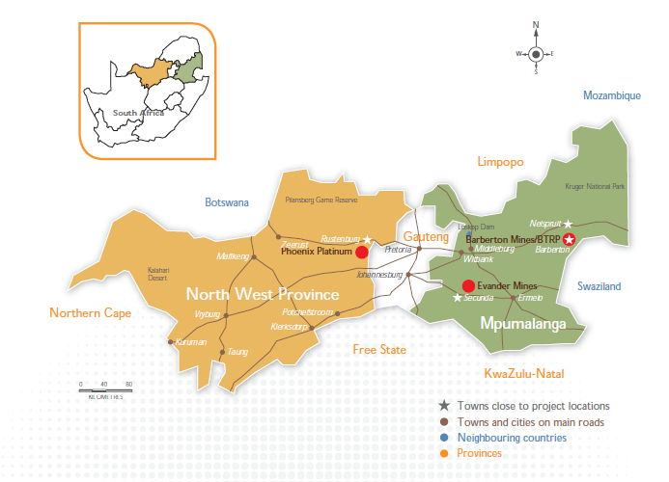
Overview of operating assets
1
Barberton is a low cost, high grade, greenstone belt producing operation which has contributed significantly to PAR’s successful track record. Barberton mines produce c.95,000oz Au and Barberton Tailings Retreatment Project (“BTRP”) produces c.20,000 oz Au per annum
  Pan African Resources is an unhedged junior gold producer with quality assets in South Africa
3
1
2
The acquisition of Evander in 2013 was transformational for PAR as it paves the way for the company to become a mid-tier gold producer with a strong, long term project pipeline. Evander is producing c.95,000oz per annum
2
3
Phoenix is a tailings retreatment plant designed to extract 12,000oz of platinum group metals per annum from chrome tailings
Source: Company website and filings
Notes:
Excluding: c.2 million oz of Au in surface resources and 423 koz of surface reserves from Evander; 79koz in surface, outside area and slime dump resources and 136koz in surface and slime dump reserves from Barbeton; and 686koz of PGM-4E resource and 62koz of PGM-4E reserves from Phoenix Platinum

Slide 16
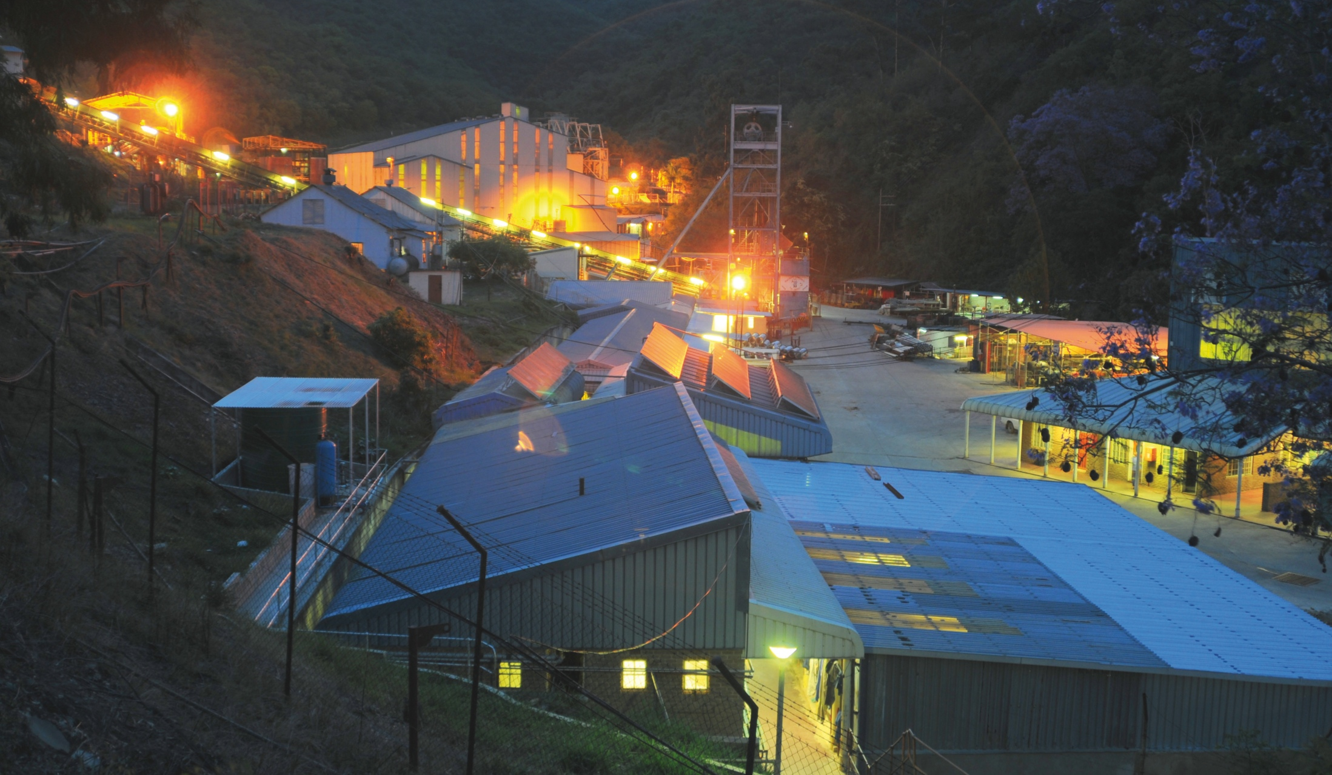
Overview of barberton mines

Slide 17
Overview of barberton mines
Barberton Mines is located c.370km east of Johannesburg and 47 km south-east of Nelspruit, South Africa
Barberton Mines comprises the following assets:
  Fairview Mine: Has a total mining area of 3,034 Ha
  New Consort Mine: Has total mining area of 2,521 Ha
  Sheba Mine: Has a total mining area of 1,705 Ha
Operations include the Barberton Tailings Treatment Plant (BTRP) which was completed during 2013
Total production capacity of 115koz per annum and produced 111.6koz of gold in the 12 months ending 30 June 2014
Barberton Mines and BTRP have LOM of 19 years and 15 years respectively
Resources and reserves
30-Jun-14 (Moz)
2014
2.9Moz
(8.9Mt @ 10.00g/t)

Slide 18
Overview of barberton mines
One of the lowest cost of production and highest grade mines in South Africa
Production statistics
Koz
Total cash costs
USD/oz
Cash Cost Breakdown
LTM June 2014

Slide 19
Overview of barberton mines

Slide 20
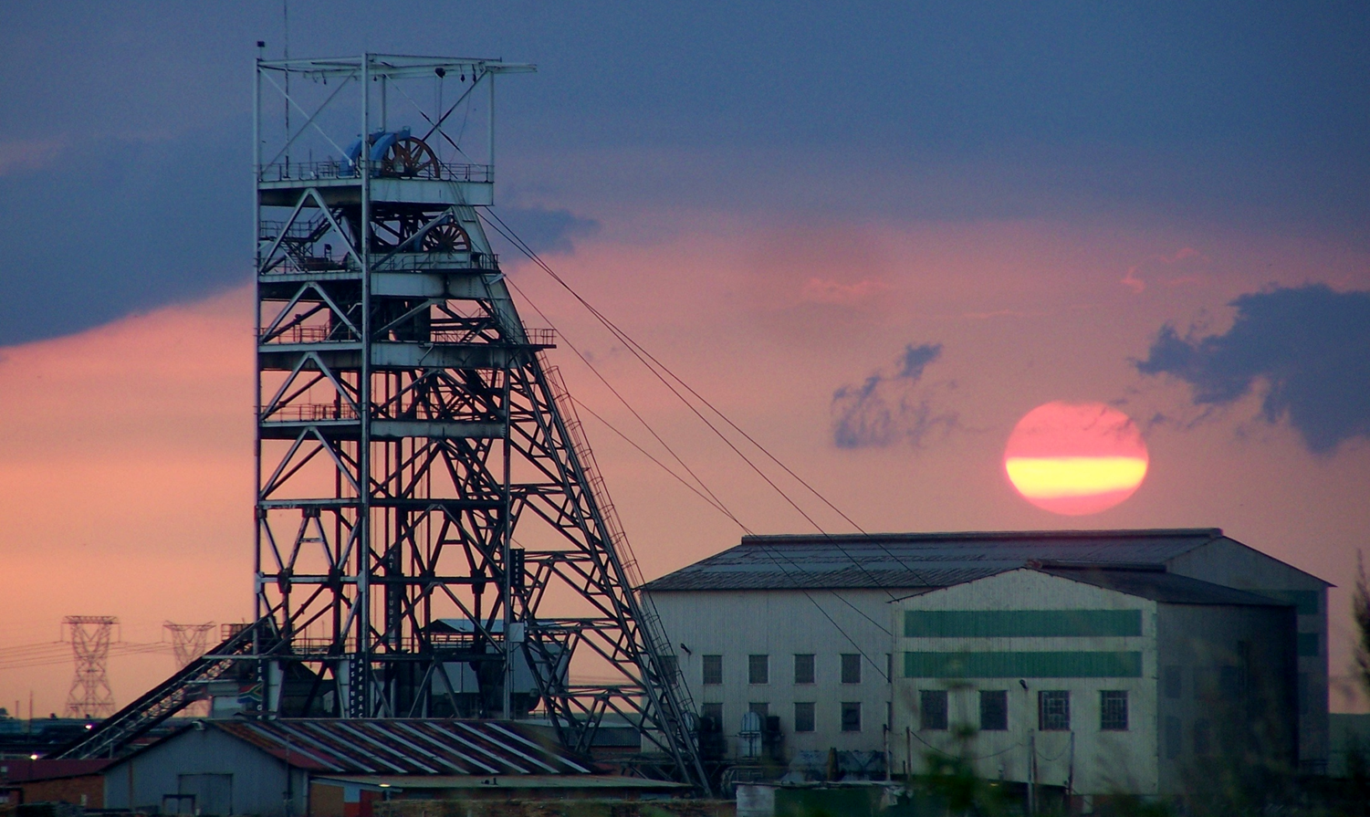
Overview of evander mines

Slide 21
Overview of evander mines
Evander was first developed in 1955 by The Union Corporation and consisted of 8 independent shafts
Currently only No. 7 Shaft and No. 8 Shaft are operational, with the rest on care and maintenance
Located approximately 120km south-east of Johannesburg in Mpumalanga
Evander’s mineral assets comprise a set of mineral resources that range from prefeasibility studies to a producing mine
Evander No. 8 Shaft and surface operations are currently generating strong cashflows
The principal economical horizon mined at Evander Mines is the Kimberley Reef, an offshoot of the Witwatersrand basin
Total production capacity of 95koz (105koz incl ETRP) all produced 76,6koz of gold in the 12 months ending 30 June 2014
Evander Mines has a LOM of 17 years
Resources and reserves
30-Jun-14 (Moz)

Slide 22
Overview of evander mines
  Estimated proven and probable reserves of
  7.8Moz (grade at 8.3g/t )

Slide 23
Overview of evander mines
  Estimated proven and probable reserves of
  1.4Moz (grade at 7.66g/t )
Evander 8 Shaft
Location | 5 km north-west of the town of Evander
Resources (Moz) | 8.4
Grade (g/t) | 11.49
Reserves (Moz) | 1.4
Grade (g/t) | 7.66
LOM (years) | 17
Au Production capacity (koz p.a.) | 100
Geology
Orebody: Kimberly Reef
Contains in-situ grades of up to c.12g/t – 18g/t
Depth: 2,100m to 2,500m
Evander 8 shaft
Production statistics
26^{O}25’S
Strategy
Evander 8 Shaft (E8)
  Maintain 100koz p.a. Au production over LOM through optimisation of resource inventory. Pipeline of organic projects which would sustain 8 shaft Au profile.
Evander 7 Shaft (E7)
26^{O}30’S
Asset specifics
Annual tonnes milled | 0.4 Mt
Operating costs (USD/oz) | 1,003.7
LOM Capex (USDm) | 86.4
Head grade (g/t) | 7.78
Average production LOM (koz p.a.) | 80.7
Stage of development | Producing
Technical documents available | CPR – Venmyn (2012)
1H14 Cash cost breakdown
26^{O}35’S
0
Scale
4km
28^{O}55’E
29^{O}00’E
29^{O}05’E
29^{O}10’E
EGM Evander Gold Assets
Evander Gold Mining Operation
Evander Gold Underground Projects
Evander Gold Tailings Projects
Operational Shafts

Slide 24
Overview of evander mines

Slide 25
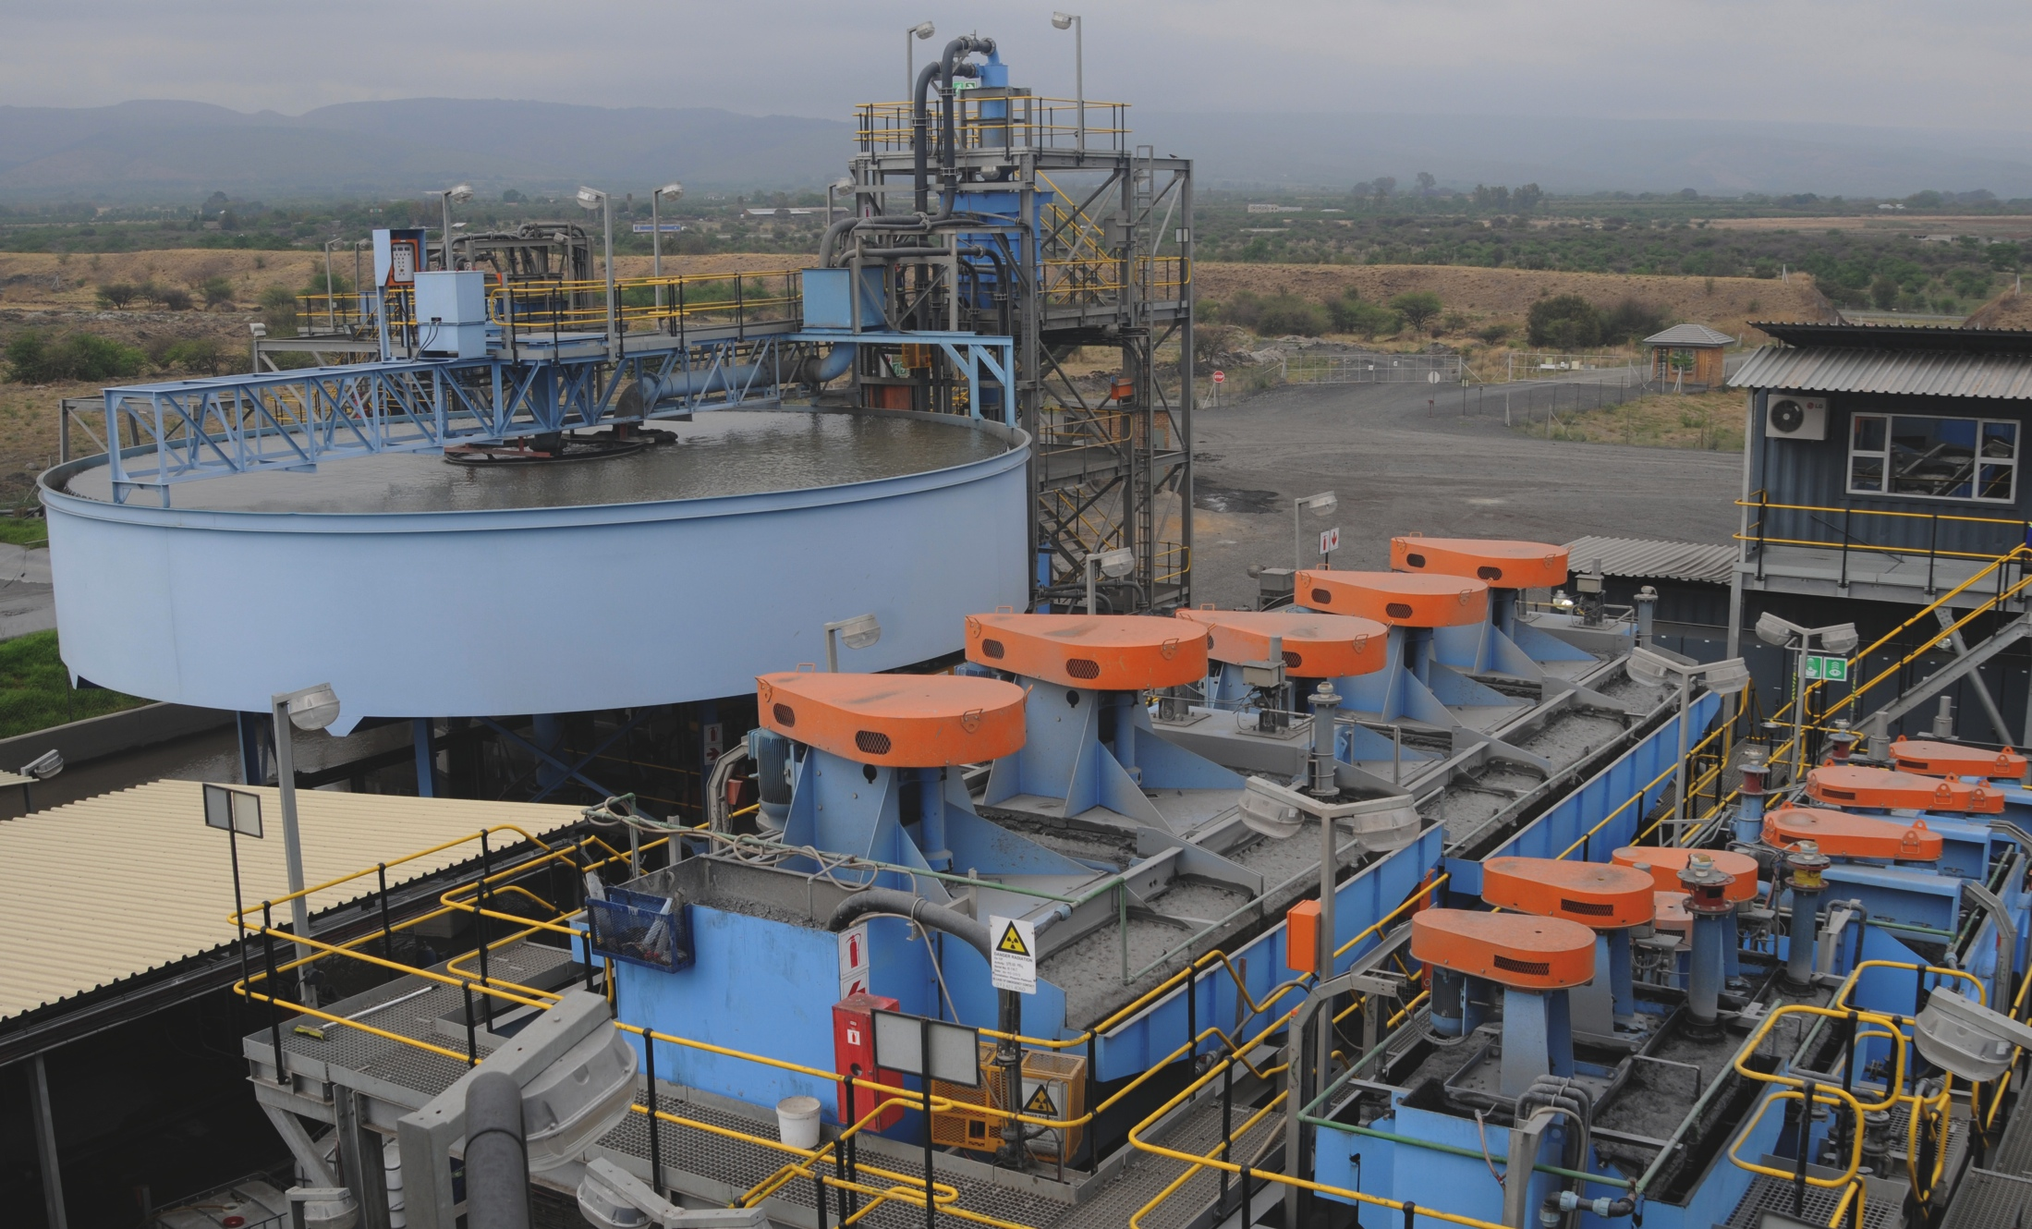
Overview of phoenix platinum

Slide 26
Overview of phoenix platinum
Operation name | Phoenix Platinum
Parent and ownership percentage | Pan African Resources PLC (100% attributable)
Holding company | Phoenix Platinum (Pty) Ltd (South African incorporated)
Country of operation | South Africa
Provincial jurisdiction | North West
Number of employees | 4
Number of contractors | 58
Commodity being mined | Platinum (61.14%), palladium (18.74%), rhodium (7.34%) and gold (0.28%), ruthenium (8.59%), iridium (3.91%) (PGE)
Geological setting | Bushveld Igneous Complex. Chrome seams containing PGMs from IFM
Mining method | Current arisings tailings produced by IFM during its mining operation are delivered directly to the CTRP, in addition to material from old tailings dams
Extraction method | SMD bead milling and floatation (concentrate is delivered to Lonmin’s Mooinooi smelter for toll extraction)
Name plate annual production
Float feed tonnage (t) | 240,000
Plant feed grade (g/t) | 3.3
PGE produced (oz) | 12,000 (sulphide feedstock), 7,200 (oxide feedstock)
Cash cost | USD746/oz
Sustainable capital per annum | ZAR1 million
LOM | 28 years

Slide 27
Growth projects

Slide 28
Significant growth potential – strong project pipeline TO SUPPLEMENT PRODUCING ASSETS
Retreatment projects
Barberton Gold
Mining operations⁴
Operating / Virgin ore projects
Operating Mine / Plant
Phoenix
Platinum CTRP¹
BTRP²
Evander 8 Shaft³
ETRP³
Under construction
No 3 Decline³
Feasibility
Rolspruit³
Pre - feasibility
ETP³
Evander South³
Poplar³
Royal Sheba⁴
Resource definition
Clutha shaft⁴
Advanced exploration
Victory Hill⁴
Early exploration
2010 Paychannel³
Identified target
ZK Extension⁴
Evander 9 Shaft³
Evander 8 Shaft³ – 26 level
Mining rights
Note:
CTRP = Chrome Tailings Retreatment Plant
BTRP = Barberton Tailings Retreatment Plant
Evander Gold Mines comprises operating Evander 8 Shaft and key related organic / brownfield expansion projects
Barberton Gold Mines comprises operating New Consort, Sheba and Fairview Shafts and key related organic / brownfield expansion projects

Slide 29
Expansion opportunities: etrp ⁽¹⁾
  Estimated proven and probable reserves of
  0.4Moz (grade at 0.32g/t )
Expansion opportunities: eGT Project ⁽²⁾
  Estimated proven and probable reserves of
  1.9Moz (grade at 0.29g/t )
Overview
ETRP Asset specifics
Annual tonnes milled | 2.4Mt
Operating costs (USD/oz) | 793.0
Head grade (g/t) | 0.32
Average production LOM (koz p.a.) | 10
LOM (years) | 17
Stage of development | Under construction
Technical documents available | CPR – Venmyn (2012) Mineral Resource Statement (2013)
  Surface tailings retreatment project that exploits tailings dams which were generated from historical mining activities at the Kinross, Winkelhaak and Leslie mines
  The tailings dams in Kinross were drilled and sampled. A total of 158 holes were drilled on a 200m x 200m grid
ETRP
26^{O}25’S
No. 8 Shaft (E8)
ETRP Strategy
No. 7 Shaft (E7)
E6
  The project is planned to be a tailings retreatment project extracting slimes from the footprints of old slimes dams. Demonstrate track record with BTRP and ETRP then leverage off expertise to further develop Winkelhaak and Leslie
No. 9 Shaft (E9)
E1
E5
No. 10 Shaft (E10
No. 2 Shaft (E2)
26^{O}30’S
E3
EGT Project Asset specifics
Annual tonnes milled | 12 Mt
Operating costs (USD/oz) | 626.1
LOM Capex (USDm) | 198
Head grade (g/t) | 0.29
Average production LOM (koz p.a.) | 50.6
Stage of development | Pre-feasibility study
Technical documents available | CPR – Venmyn (2012)
ETRP
Location | Evander
Resources (Moz) | 0.4
Grade (g/t) | 0.32
26^{O}35’S
Scale
4km
28^{O}55’E
29^{O}00’E
29^{O}05’E
29^{O}10’E
EGT
EGT Projects
Location | Evander
Resources (Moz) | 1.9
Grade (g/t) | 0.29
Reserves (Moz) | 0.4
Grade (g/t) | 0.32
EGM Evander Gold Assets
Evander Gold Mining Operation
Evander Gold Underground Projects
Evander Gold Tailings Projects
Operational Shafts
Old Shafts
Notes:
ETRP is the Evander Tailings Retreatment Plant
EGT is the Evander Gold Tailings project

Slide 30
Expansion opportunities: evander south
  Estimated proven and probable reserves of
  5.2Moz (grade at 7.66g/t )
Evander South Project
Location | South-western limb of the Evander Basin
Resources (Moz) | 5,2
Grade (g/t) | 7,66
  Geology
  Orebody: Kimberly Reef
  In-situ grade: 6-8g/t
  Surface boreholes drilled: 116
  Depth: 300-1,200m
Evander south project extension
Strategy
26^{O}25’S
Asset specifics (cont’d)
Technical documents available | Technical Report – Mineral Reserve Estimation, ExplorMine Consultancy (2010) Pre-feasibility Study – SRK (2010) CPR – Venmyn (2012)
  Progress the project from pre-feasibility to feasibility. Mine to be developed thus optimising Evander’s mineral inventory. Shallowest ore body of the three underground projects, but lower grades.
Evander South project
No. 8 Shaft (E8)
No. 7 Shaft (E7)
26^{O}30’S
Asset specifics
Annual tonnes milled | 1.2 Mt
Operating costs (USD/oz) | 685
Average production LOM (koz p.a.) | 106.5
Stage of development | Pre-feasibility Study
26^{O}35’S
0
Scale
4km
28^{O}55’E
29^{O}00’E
29^{O}05’E
29^{O}10’E
Evander south project extension
EGM Evander Gold Assets
Evander Gold Mining Operation
Evander Gold Underground Projects
Evander Gold Tailings Projects
Operational Shafts

Slide 31
Expansion opportunities: poplar
  Estimated proven and probable reserves of
  5.4Moz (grade at 7.4g/t )
Poplar project
Location | North-western limb of the Evander Basin
Resources (Moz) | 6.3
Grade g/t | 6.84
LOM (years) | 20
  Geology
  Orebody: Kimberly Reef
  In-situ grade: 7 - 10g/t
  Surface boreholes drilled: 104
  Depth: 500 - 1,200m
Poplar project
Strategy
Asset specifics (cont’d)
Technical documents available | Technical Report: Mineral Reserve Estimation – ExplorMine Consulting (2011) Pre-feasibility Study – Harmony (2003) CPR – Venmyn (2012)
  Progress the project from pre-feasibility to feasibility then mine development.
No. 8 Shaft (E8)
26^{O}25’S
Poplar project extension
No. 7 Shaft (E7)
26^{O}30’S
Asset specifics
Annual tonnes milled | 1.2 Mt
Operating costs (USD/oz) | 412.3
LOM Capex (USDm) | 910
Average production LOM (koz p.a.) | 174.9
Stage of development | Pre-feasibility Study
26^{O}35’S
0
Scale
4km
28^{O}55’E
29^{O}00’E
29^{O}05’E
29^{O}10’E
EGM Evander Gold Assets
Evander Gold Mining Operation
Evander Gold Underground Projects
Evander Gold Tailings Projects
Operational Shafts

Slide 32
Expansion opportunities: rolspruit
  Estimated proven and probable reserves of
  8.9Moz (grade at 10.86g/t )
Rolspruit project
Location | Adjacent to Evander 8 Shaft
Resources (Moz) | 8.9
Grade (g/t) | 10.86
LOM (years) | +20
Reserves (Moz) | 6.5
Grade (g/t) | 8.60
LOM stead-state production (koz p.a.) | 340
  Geology
  Orebody: Kimberly Reef
  In-situ grades of c.10g/t – 12g/t
  Down-dip extension of the Kinross Payshoot
  High level of confidence in mineral resource and mineral reserve
  Project stage: Feasibility study
  Depth: 1,400m - 3,300m
  Surface boreholes drilled: 53
Rolspruit project
Strategy
26^{O}25’S
No. 8 Shaft (E8)
  Development of a robust mineral asset from feasibility study to bankable feasibility study. The mineral asset has a high level of confidence in geology and resource quality since it is the extension of the kinross payshoot channel
No. 7 Shaft (E7)
26^{O}30’S
Asset specifics (cont’d)
Technical documents available | Mineral Resource Estimation – ExplorMine Consulting (2011) Pre-feasibility study (Turgis, 2012) CPR – Venmyn (2012) SNC-Lavalin Report
Asset specifics
Annual tonnes milled | 1.2 Mt
Operating costs (USD/oz) | 406.9
LOM Capex (USDm) | 1,567
Steady-state head grade (g/t) | 8.31
Average production LOM (koz p.a.) | 296.3
Stage of development | Feasibility
26^{O}35’S
0
Scale
4km
28^{O}55’E
29^{O}00’E
29^{O}05’E
29^{O}10’E
EGM Evander Gold Assets
Evander Gold Mining Operation
Evander Gold Underground Projects
Evander Gold Tailings Projects
Operational Shafts
32

Slide 33
INVESTMENT CASE

Slide 34
OUR INVESTMENT CASE
Proven business model and track record
  Culture of delivery – Barberton’s BTRP and Evander ETRP
  Quality assets delivering good returns
  People focused, limited overheads and no unnecessary “red tape”
Clear understanding of what drives the value of our business
  “Do the right things right”
Delivering a cash return to shareholders
  Attractive dividend yield
  High margin assets allow for dividend to be maintained
Preferred gold investment
  Profitable production growth from long life assets
  Significant resource and reserve base
  Ability to conclude further value accretive acquisitions
  Management team that continues to drive value for shareholders

